Slide 1
Capstone Project
Mobile price range prediction
By
Akhilesh Kumar
Mentor: Richa Sharma
Date: 05.09.2021

Slide 2
Objective
To understand sales data of mobile phones and factors which drive the prices
To predict the price range of the mobile phone

Slide 3
Dataset Info
Battery_power - Total energy a battery can store in one time measured in mAh
Blue - Has bluetooth or not
Clock_speed - speed at which microprocessor executes instructions
Dual_sim - Has dual sim support or not
Fc - Front Camera mega pixels
Four_g - Has 4G or not
Int_memory - Internal Memory in Gigabytes
M_dep - Mobile Depth in cm
Mobile_wt - Weight of mobile phone
N_cores - Number of cores of processor
Pc - Primary Camera mega pixels
Px_height - Pixel Resolution Height
Px_width - Pixel Resolution Width
Ram - Random Access Memory in Mega Bytes
Sc_h - Screen Height of mobile in cm
Sc_w - Screen Width of mobile in cm
Talk_time - longest time that a single battery charge will last when you are
Three_g - Has 3G or not
Touch_screen - Has touch screen or not
Wifi - Has wifi or not
Price_range - This is the target variable with value of 0(low cost), 1(medium cost), 2(high cost) and 3(very high cost)

Slide 4
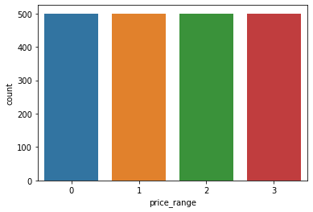
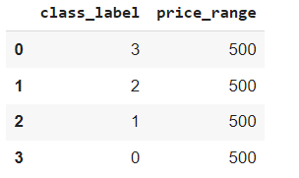
Overall Insight into Dataset
There was no missing or null values in the dataset
Also, no outliers were present (by using local outlier factor)

Slide 5
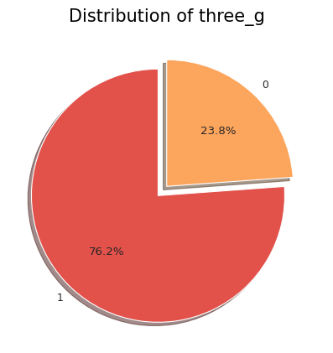
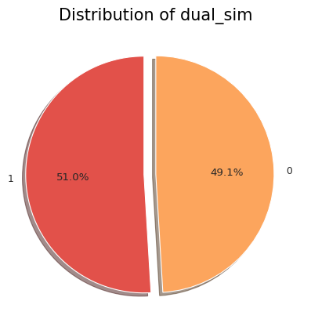

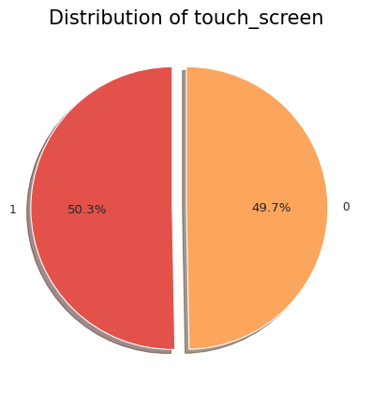

EDA of the categorical variables

Slide 6
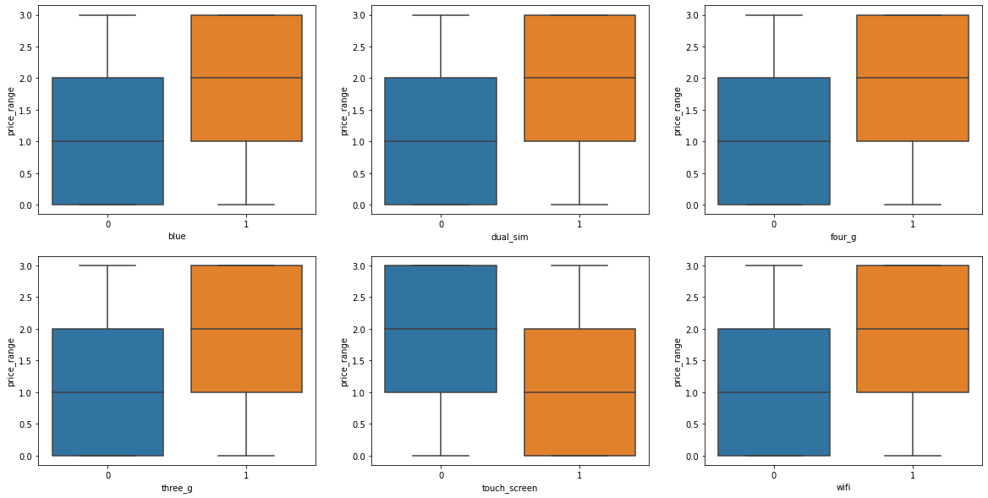
Boxplot of the categorical variables
If the categorical features are present, then the price range is high (except for the touch screen)

Slide 7
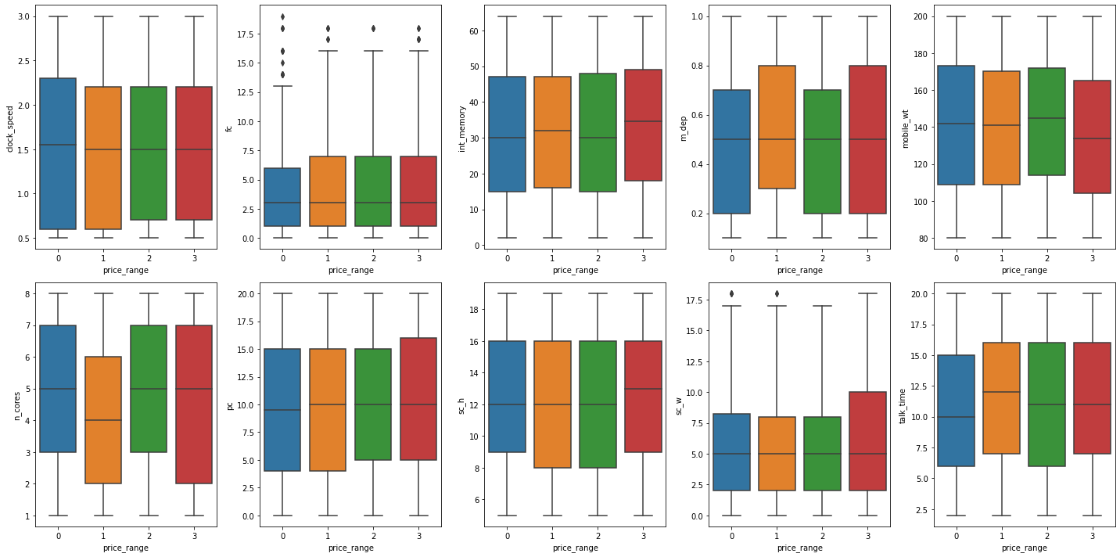
Boxplot for the numerical features
The price range is not varying much with the numerical features

Slide 8
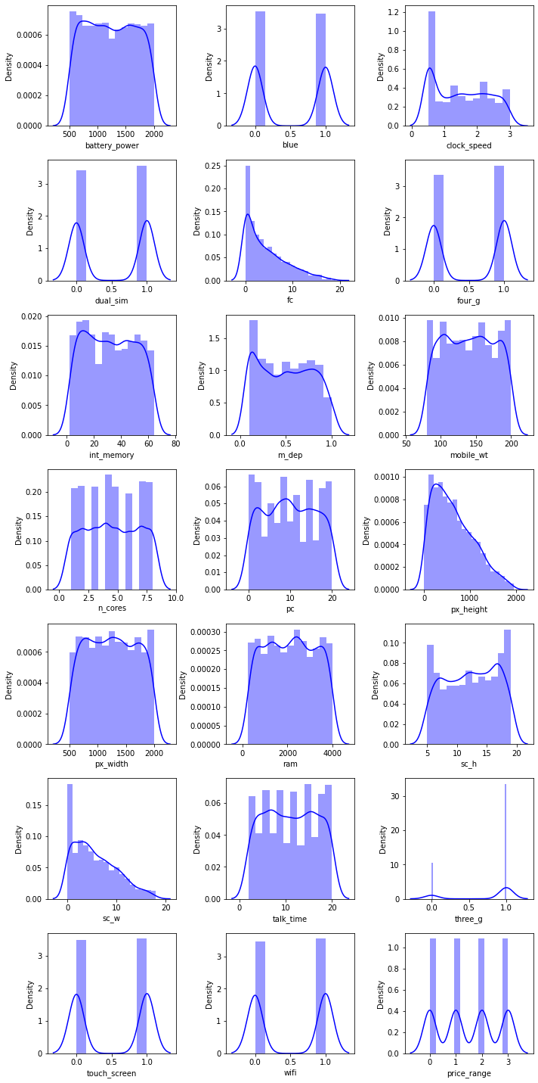
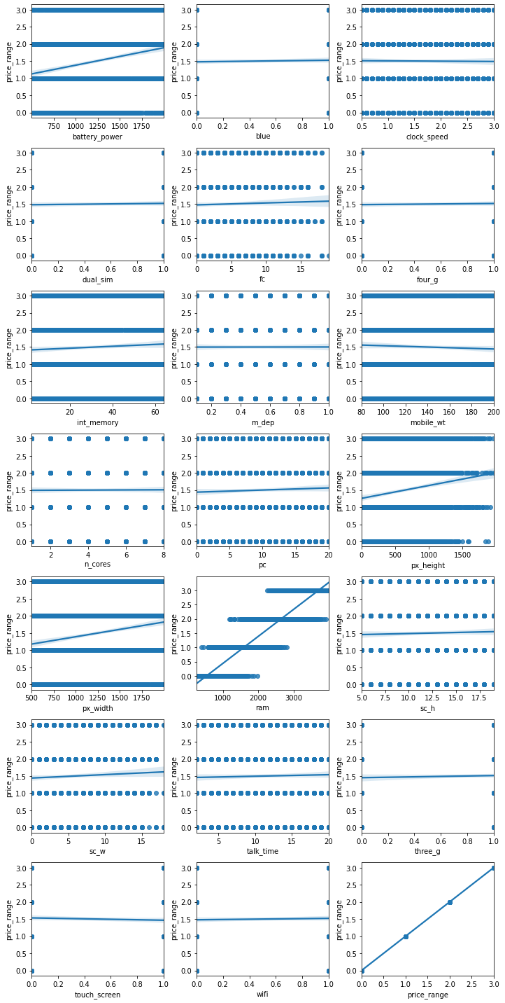
Battery power, clock_speed, dual_sim, m_dep, mobile_wt, px_height, px_width, ram, sc_h, talk_time got linear relationship with our dependent variable price range

Slide 9
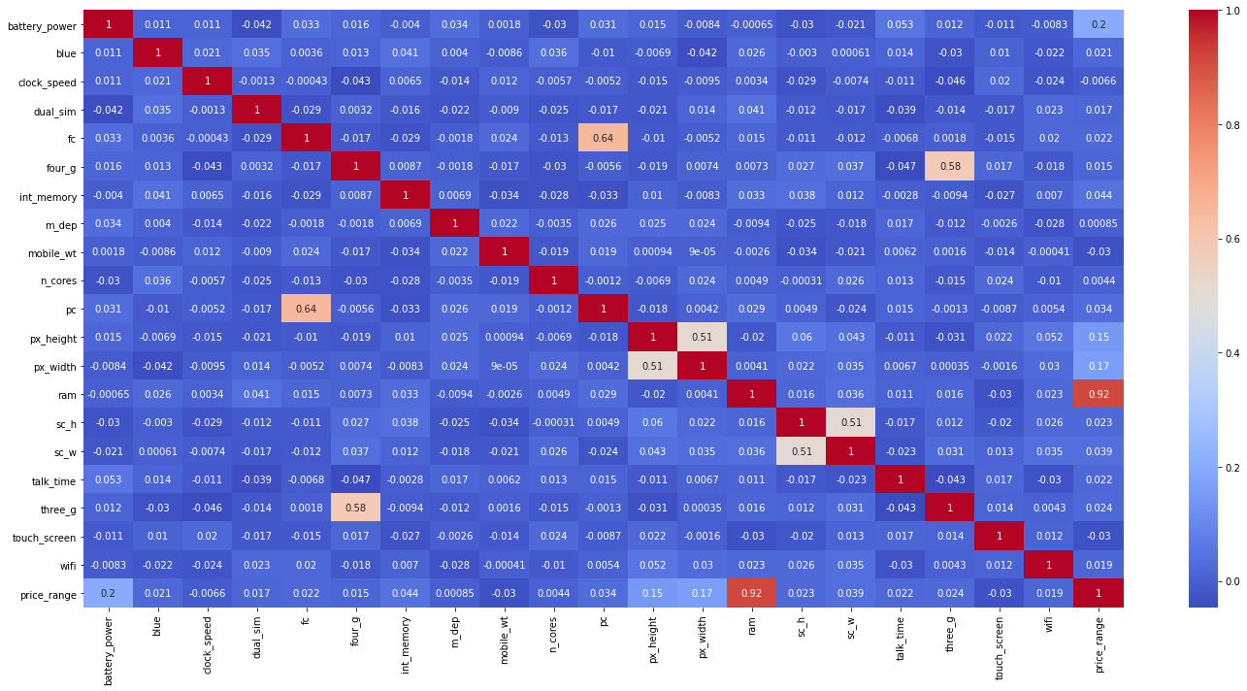
Heat map
Ram shows strong linear relationship with price range

Slide 10
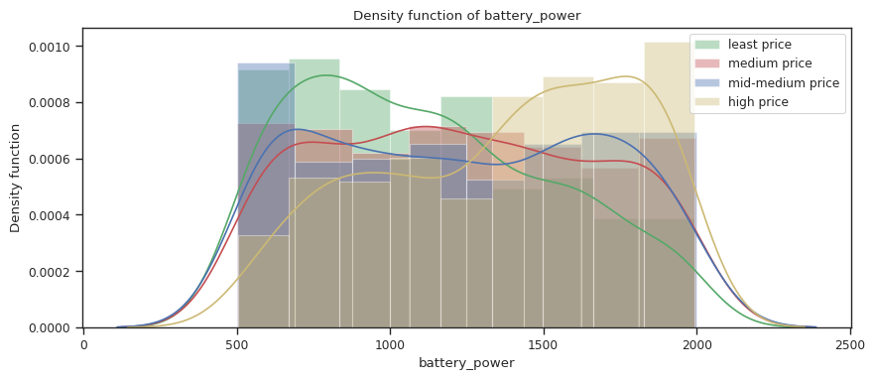
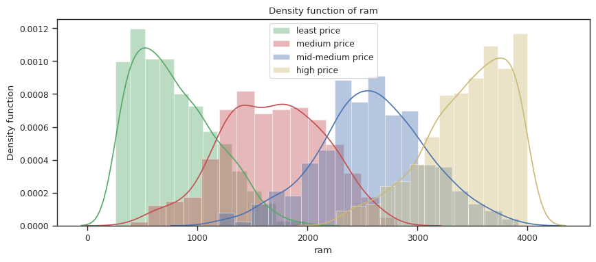
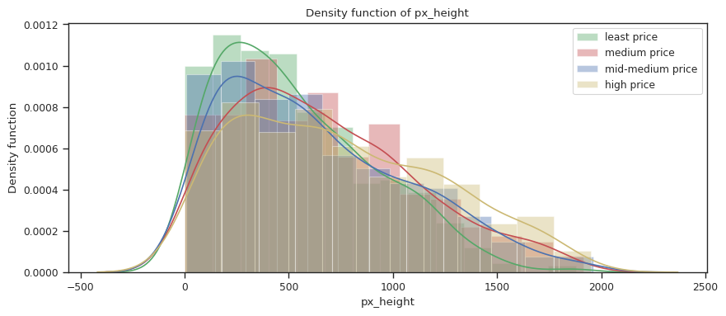
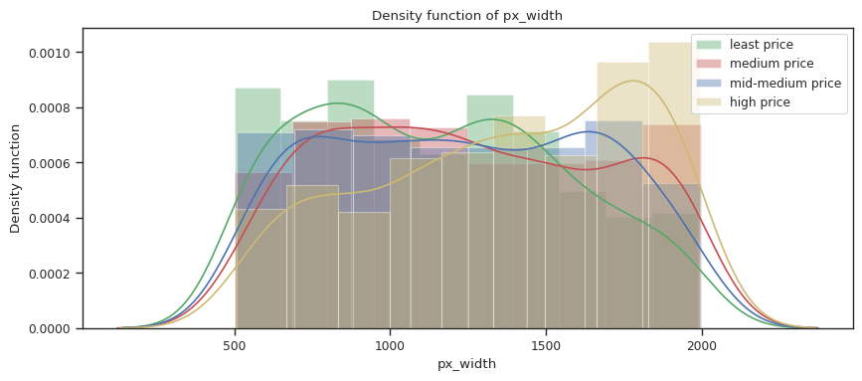
Density plots for important features

Slide 11
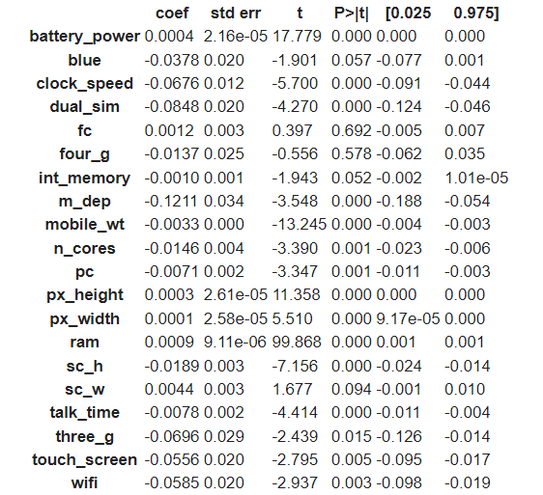
Feature importance using stats model
Battery power, clock_speed, dual_sim, m_dep, mobile_wt, px_height, px_width, ram, sc_h, talk_time got linear relationship with our dependent variable price range

Slide 12
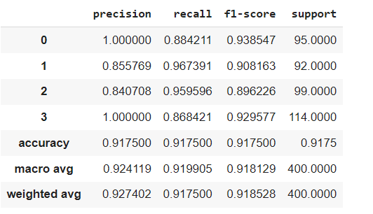
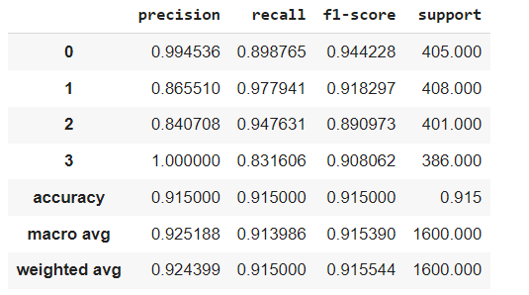
Performance metrics for Linear regression models

Slide 13
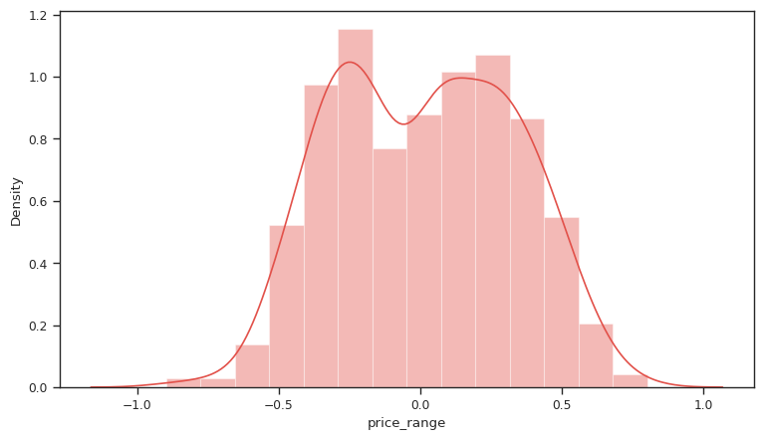
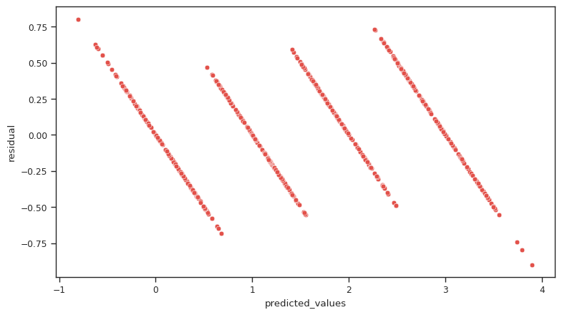
Checking assumption for linear regression

Slide 14
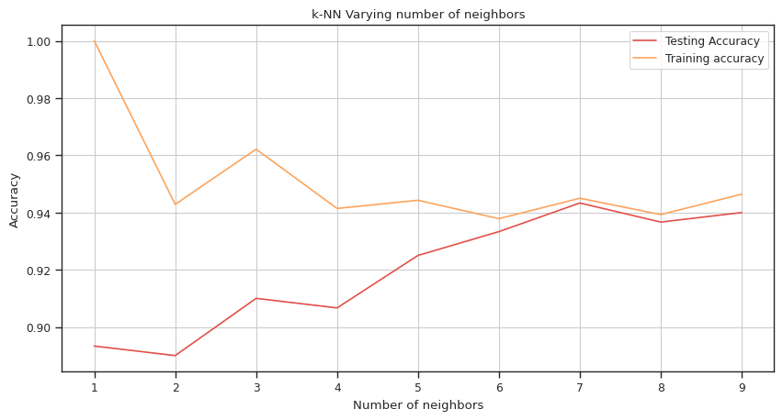
KNN train-test plot
From the graph it can be inferred that there are 7 optimum number of neighbors

Slide 15
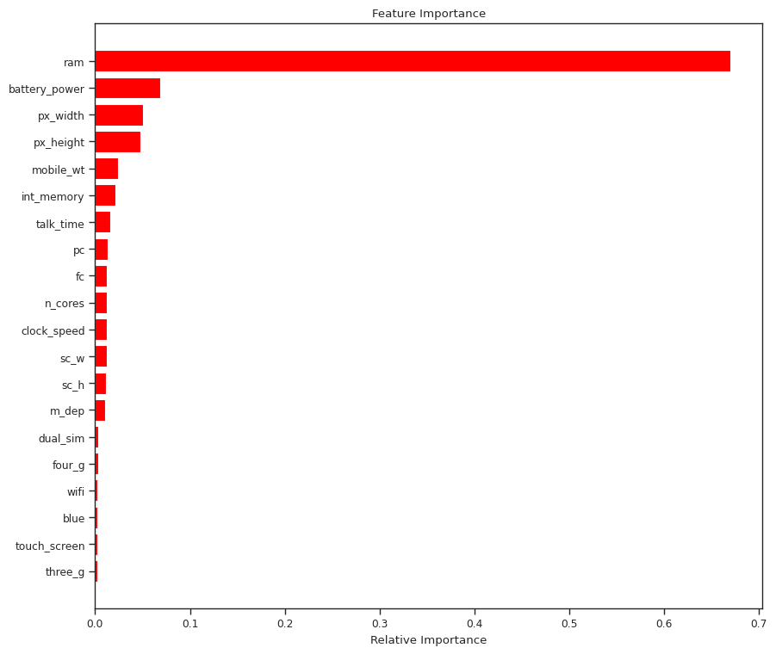
Feature importance using random forest
From the graph it can be inferred that ram has strong relationship with dependent variable price range
Battery power, px_width, px_height has also got a decent relationship with price range

Slide 16
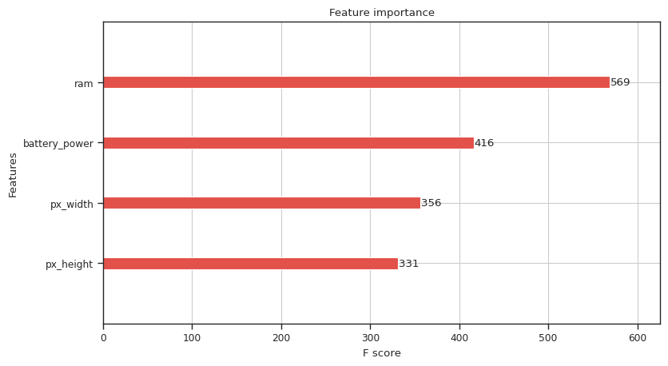
Feature importance using XG boost
From the graph it can be inferred that ram, Battery power, px_width, px_height are important features for XG boost

Slide 17
Performance metrics for diff. models (training set)
Algorithm | Class label | Performance parameters
 |  | Accuracy | Precision | Recall | F1 score
Linear regression | 0 | 0.9175 | 1.0000 | 0.8842 | 0.9385
 | 1 |  | 0.8558 | 0.9674 | 0.9082
 | 2 |  | 0.8407 | 0.9596 | 0.8962
 | 3 |  | 1.0000 | 0.8684 | 0.9296
Random forest | 0 | 0.9485 | 0.9630 | 0.9734 | 0.9671
 | 1 |  | 0.9071 | 0.9095 | 0.9083
 | 2 |  | 0.9385 | 0.9197 | 0.9290
 | 3 |  | 0.9882 | 0.9970 | 0.9926
Decision trees | 0 | 0.8921 | 0.9316 | 0.9369 | 0.9342
 | 1 |  | 0.8793 | 0.8383 | 0.8583
 | 2 |  | 0.8588 | 0.8366 | 0.8476
 | 3 |  | 0.8975 | 0.9614 | 0.9283
XG boost | 0 | 1 | 1 | 1 | 1
 | 1 |  | 1 | 1 | 1
 | 2 |  | 1 | 1 | 1
 | 3 |  | 1 | 1 | 1
KNN | 0 | 0.9450 | 0.9687 | 0.9770 | 0.9728
 | 1 |  | 0.9274 | 0.9452 | 0.9362
 | 2 |  | 0.9193 | 0.9140 | 0.9166
 | 3 |  | 0.9665 | 0.9436 | 0.9549

Slide 18
Performance metrics for diff. models (test set)
Algorithm | Class label | Performance parameters
 |  | Accuracy | Precision | Recall | F1 score
Linear regression | 0 | 0.9175 | 1.0000 | 0.8842 | 0.9385
 | 1 |  | 0.8558 | 0.9674 | 0.9082
 | 2 |  | 0.8407 | 0.9596 | 0.8962
 | 3 |  | 1.0000 | 0.8684 | 0.9296
Random forest | 0 | 0.9686 | 0.9801 | 0.9470 | 0.9502
 | 1 |  | 0.8800 | 0.9041 | 0.8919
 | 2
 |  |  | 0.8523 | 0.8581 | 0.8552
 | 3 |  | 0.9271 | 0.9032 | 0.9150
Decision Trees | 0 | 0.8283 | 0.9266 | 0.9205 | 0.9235
 | 1 |  | 0.7968 | 0.7555 | 0.7756
 | 2 |  | 0.7517 | 0.7019 | 0.7260
 | 3 |  | 0.8287 | 0.9202 | 0.8720
XG boost | 0 | 0.9200 | 0.9662 | 0.9470 | 0.9565
 | 1 |  | 0.8726 | 0.9383 | 0.9043
 | 2 |  | 0.9065 | 0.8513 | 0.8780
 | 3 |  | 0.9359 | 0.9419 | 0.9389
KNN | 0 | 0.9433 | 0.9677 | 0.9934 | 0.9804
 | 1 |  | 0.9403 | 0.9333 | 0.9368
 | 2 |  | 0.9127 | 0.9007 | 0.9067
 | 3 |  | 0.9506 | 0.9477 | 0.9477

Slide 19
Challenges
Number of data points were too low to draw some good inferences from the data.
Most of the features were not linearly related with target, and there's some multicollinearity in the data.
The number of features was fair enough given the number of observations, but when used for real world problems, it is not sufficient to make good predictions.

Slide 20
Conclusion
Battery power, clock_speed, dual_sim, m_dep, mobile_wt, px_height, px_width, ram, sc_h, talk_time got linear relationship with our dependent variable price range
Ram has the highest impact on the price of the mobile.
Surprisingly Linear regression performed well in this classification problem. But there was heteroscedasity, hence we moved on to non-linear models.
Using decision tree, we got a decent performance after tuning the hyperparameters. We found that there's some overfitting which is a usual problem with DT.
After DT, we have tried different bagging and boosting models which performed well as compared to the above models.
Our XG boost model is also getting overfitted, so we could say that KNN is the best algorithm for the dataset.

Slide 21
Thank you

